Slide 1
Stability Setup Project
Andrew Chen

Slide 2
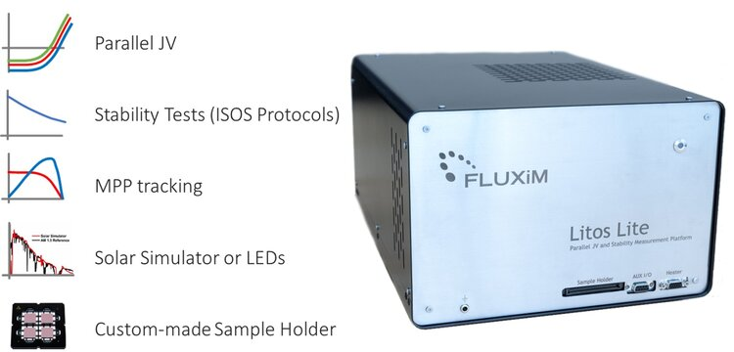
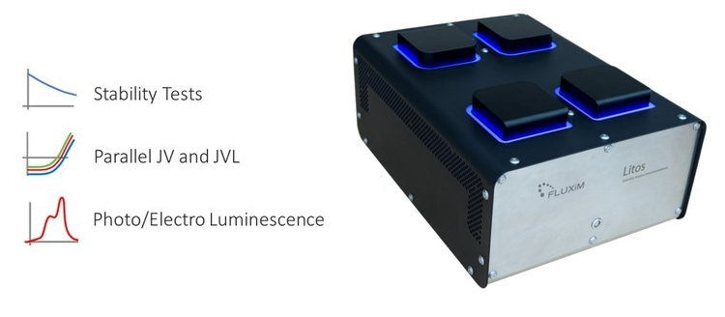
Purpose
To produce results comparable to the Litos/Litos Lite, but at a price that is magnitudes cheaper.
To enable parallel 500-hour stability testing of 8 - 32 devices.

Slide 3
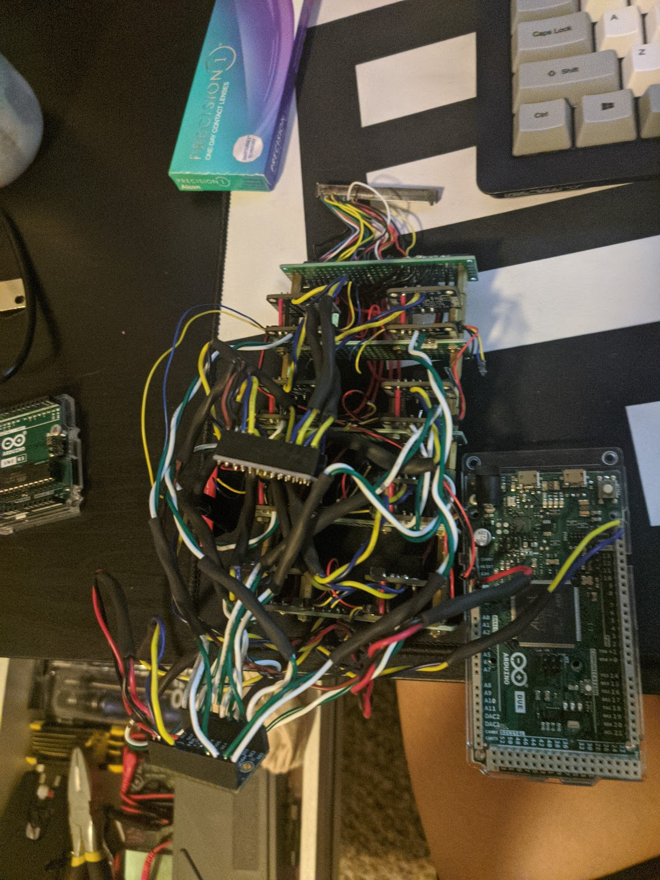
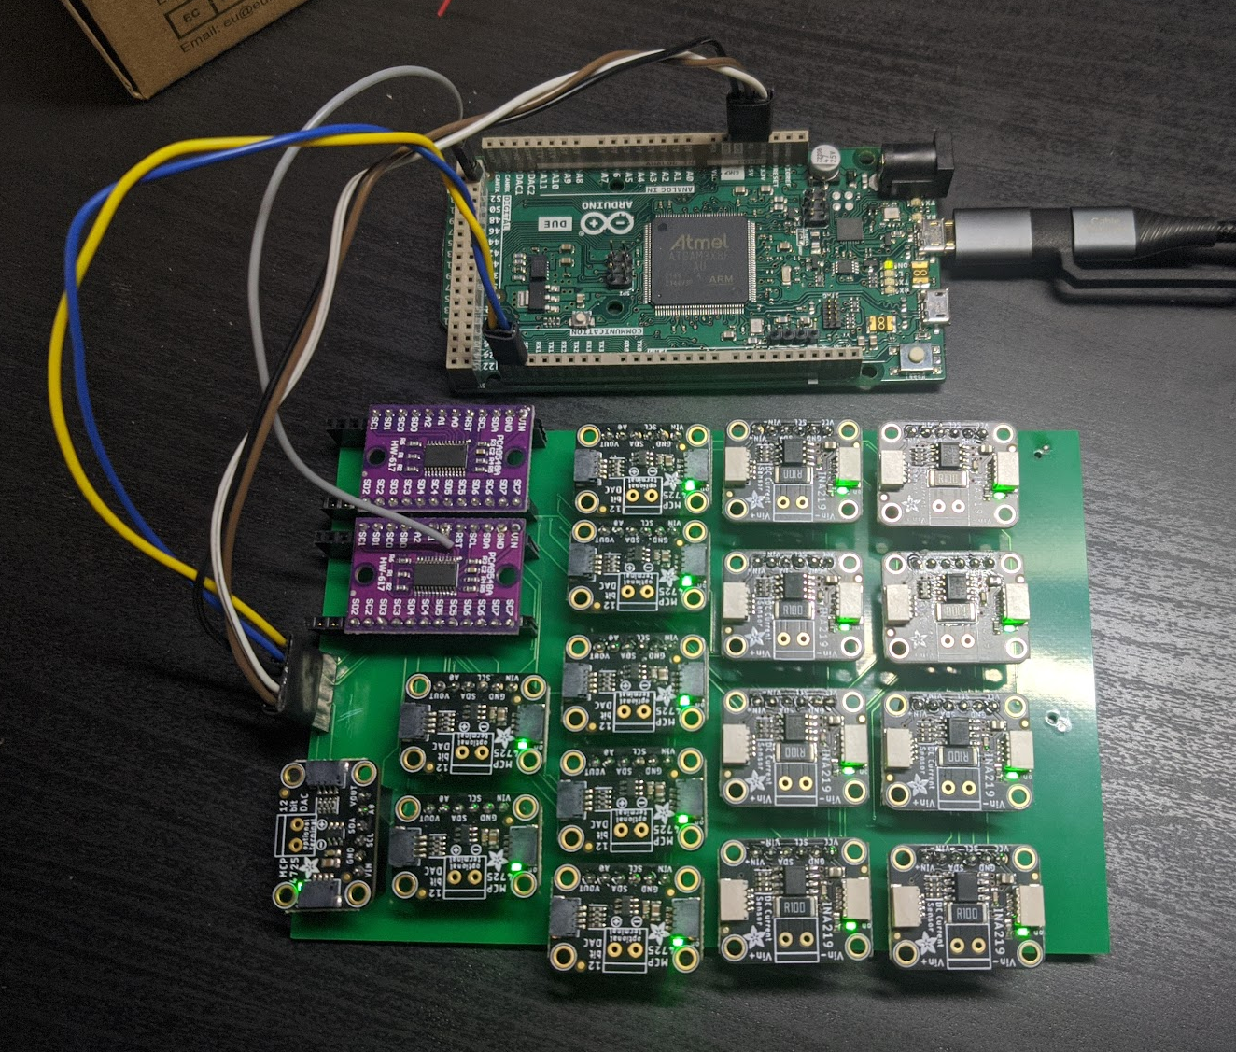
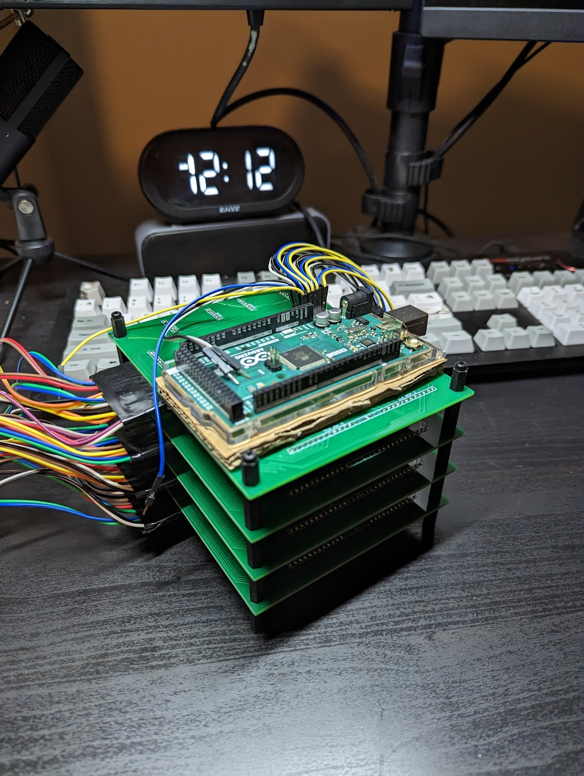
development Timeline
Aug 2022
Prototype for measuring one full device finished and tested.
Dec 2022
Adapted prototype to a circuit board form.
Apr 2023
Parallel 4 device JV and MPPT measurement capabilities. 2 setups completed.
Notes:
biggest stoppage in development is troubleshooting
wiring bugs

Slide 4
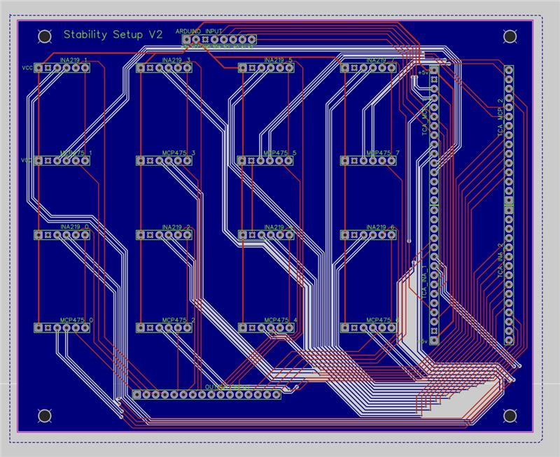
Features
code Stack
Custom Circuit Board
Very cost effective
Fully customizable measurements (scan rate, voltage range/step size)
Automatically starts MPPT measurement at Vmpp voltage taken from JV scan.
Periodic JV scans during MPPT measurements.
Automated graph storage and organization.
70% written in python, 30% in C++
Very easily reproducible.
Full setup fabrication time is under 6 hours.
Only basic soldering skills required (just breadboard style pins).
Current Setup Cost is under $750. (Litos Lite costs around 60k)
JV and MPPT have performed within 5% error of Litos Lite on single device setup.

Slide 5
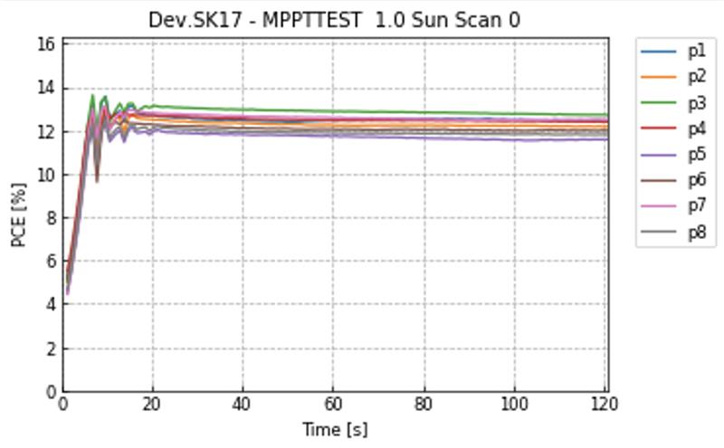
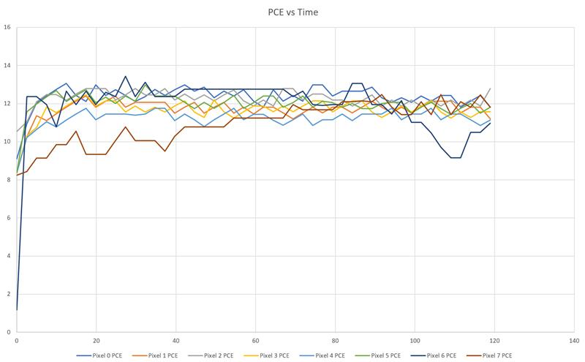
Best Performing MPPT Trial (1 device setup: 9/9/2022)
Litos Lite
My Setup
Percent error of the average over the last 40s of trials: 3.44%

Slide 6
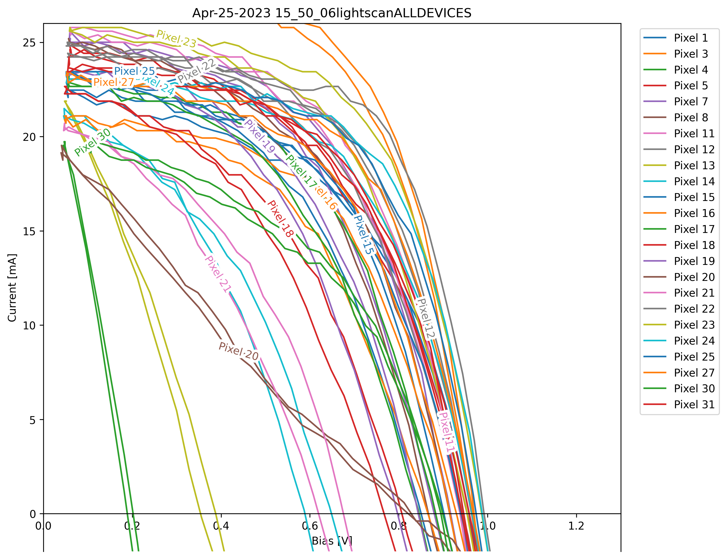
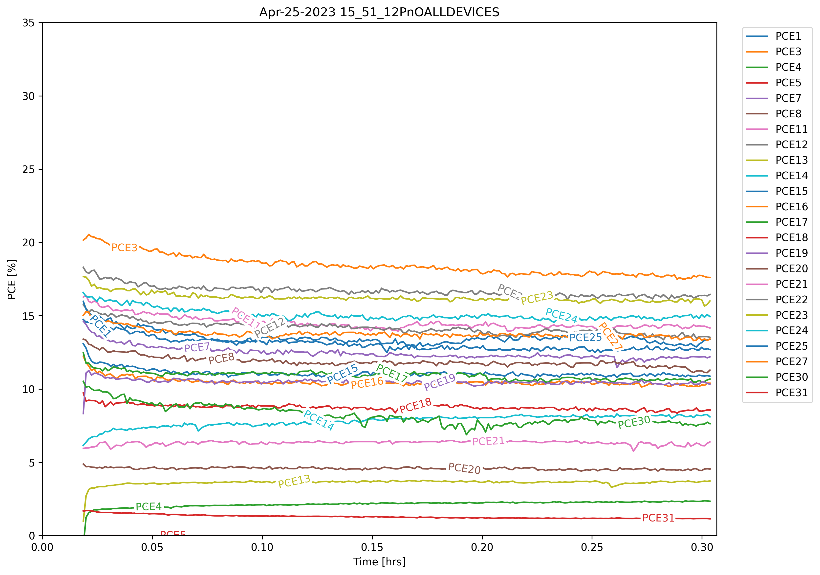
Sample Measurement (4 device setup: 4/25/2023)
JV Scan
MPPT measurement

Slide 7
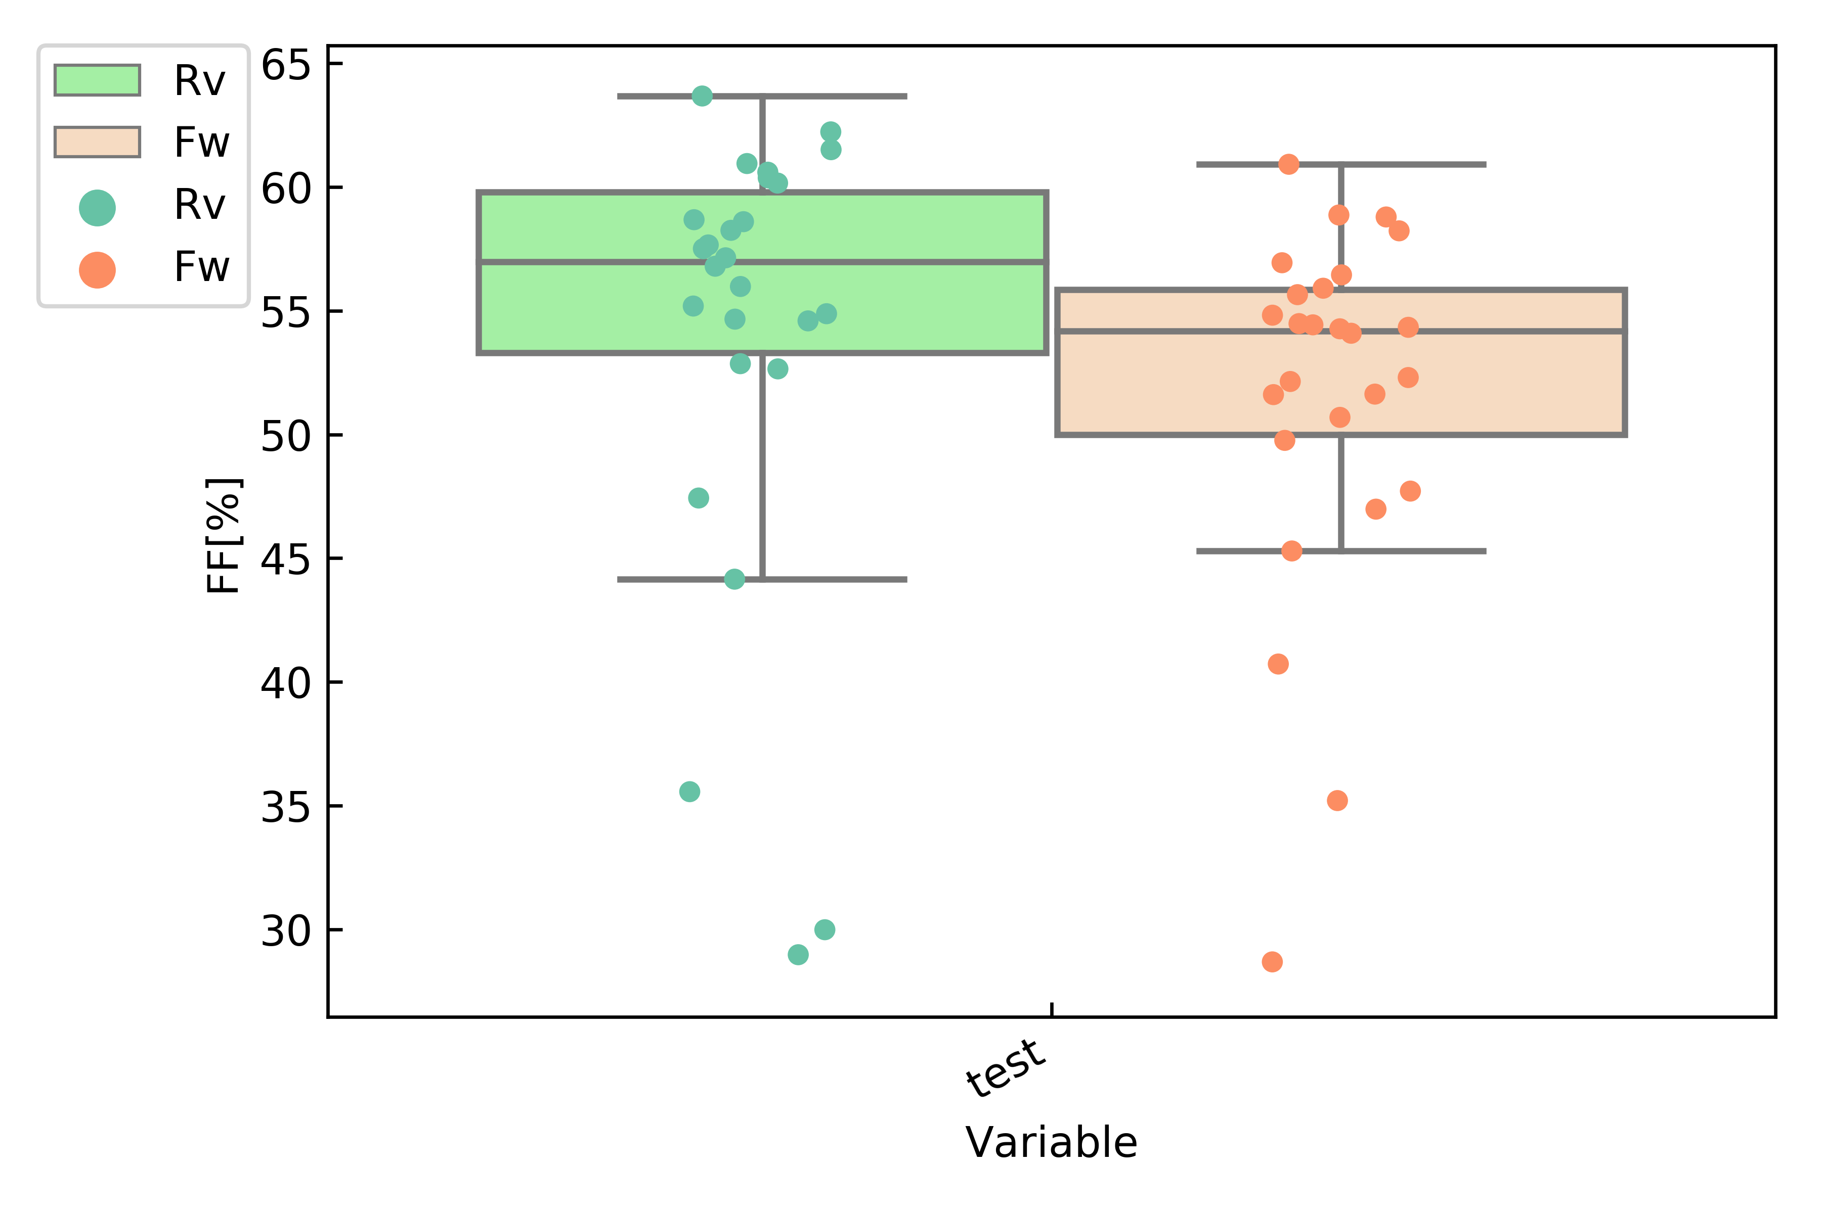
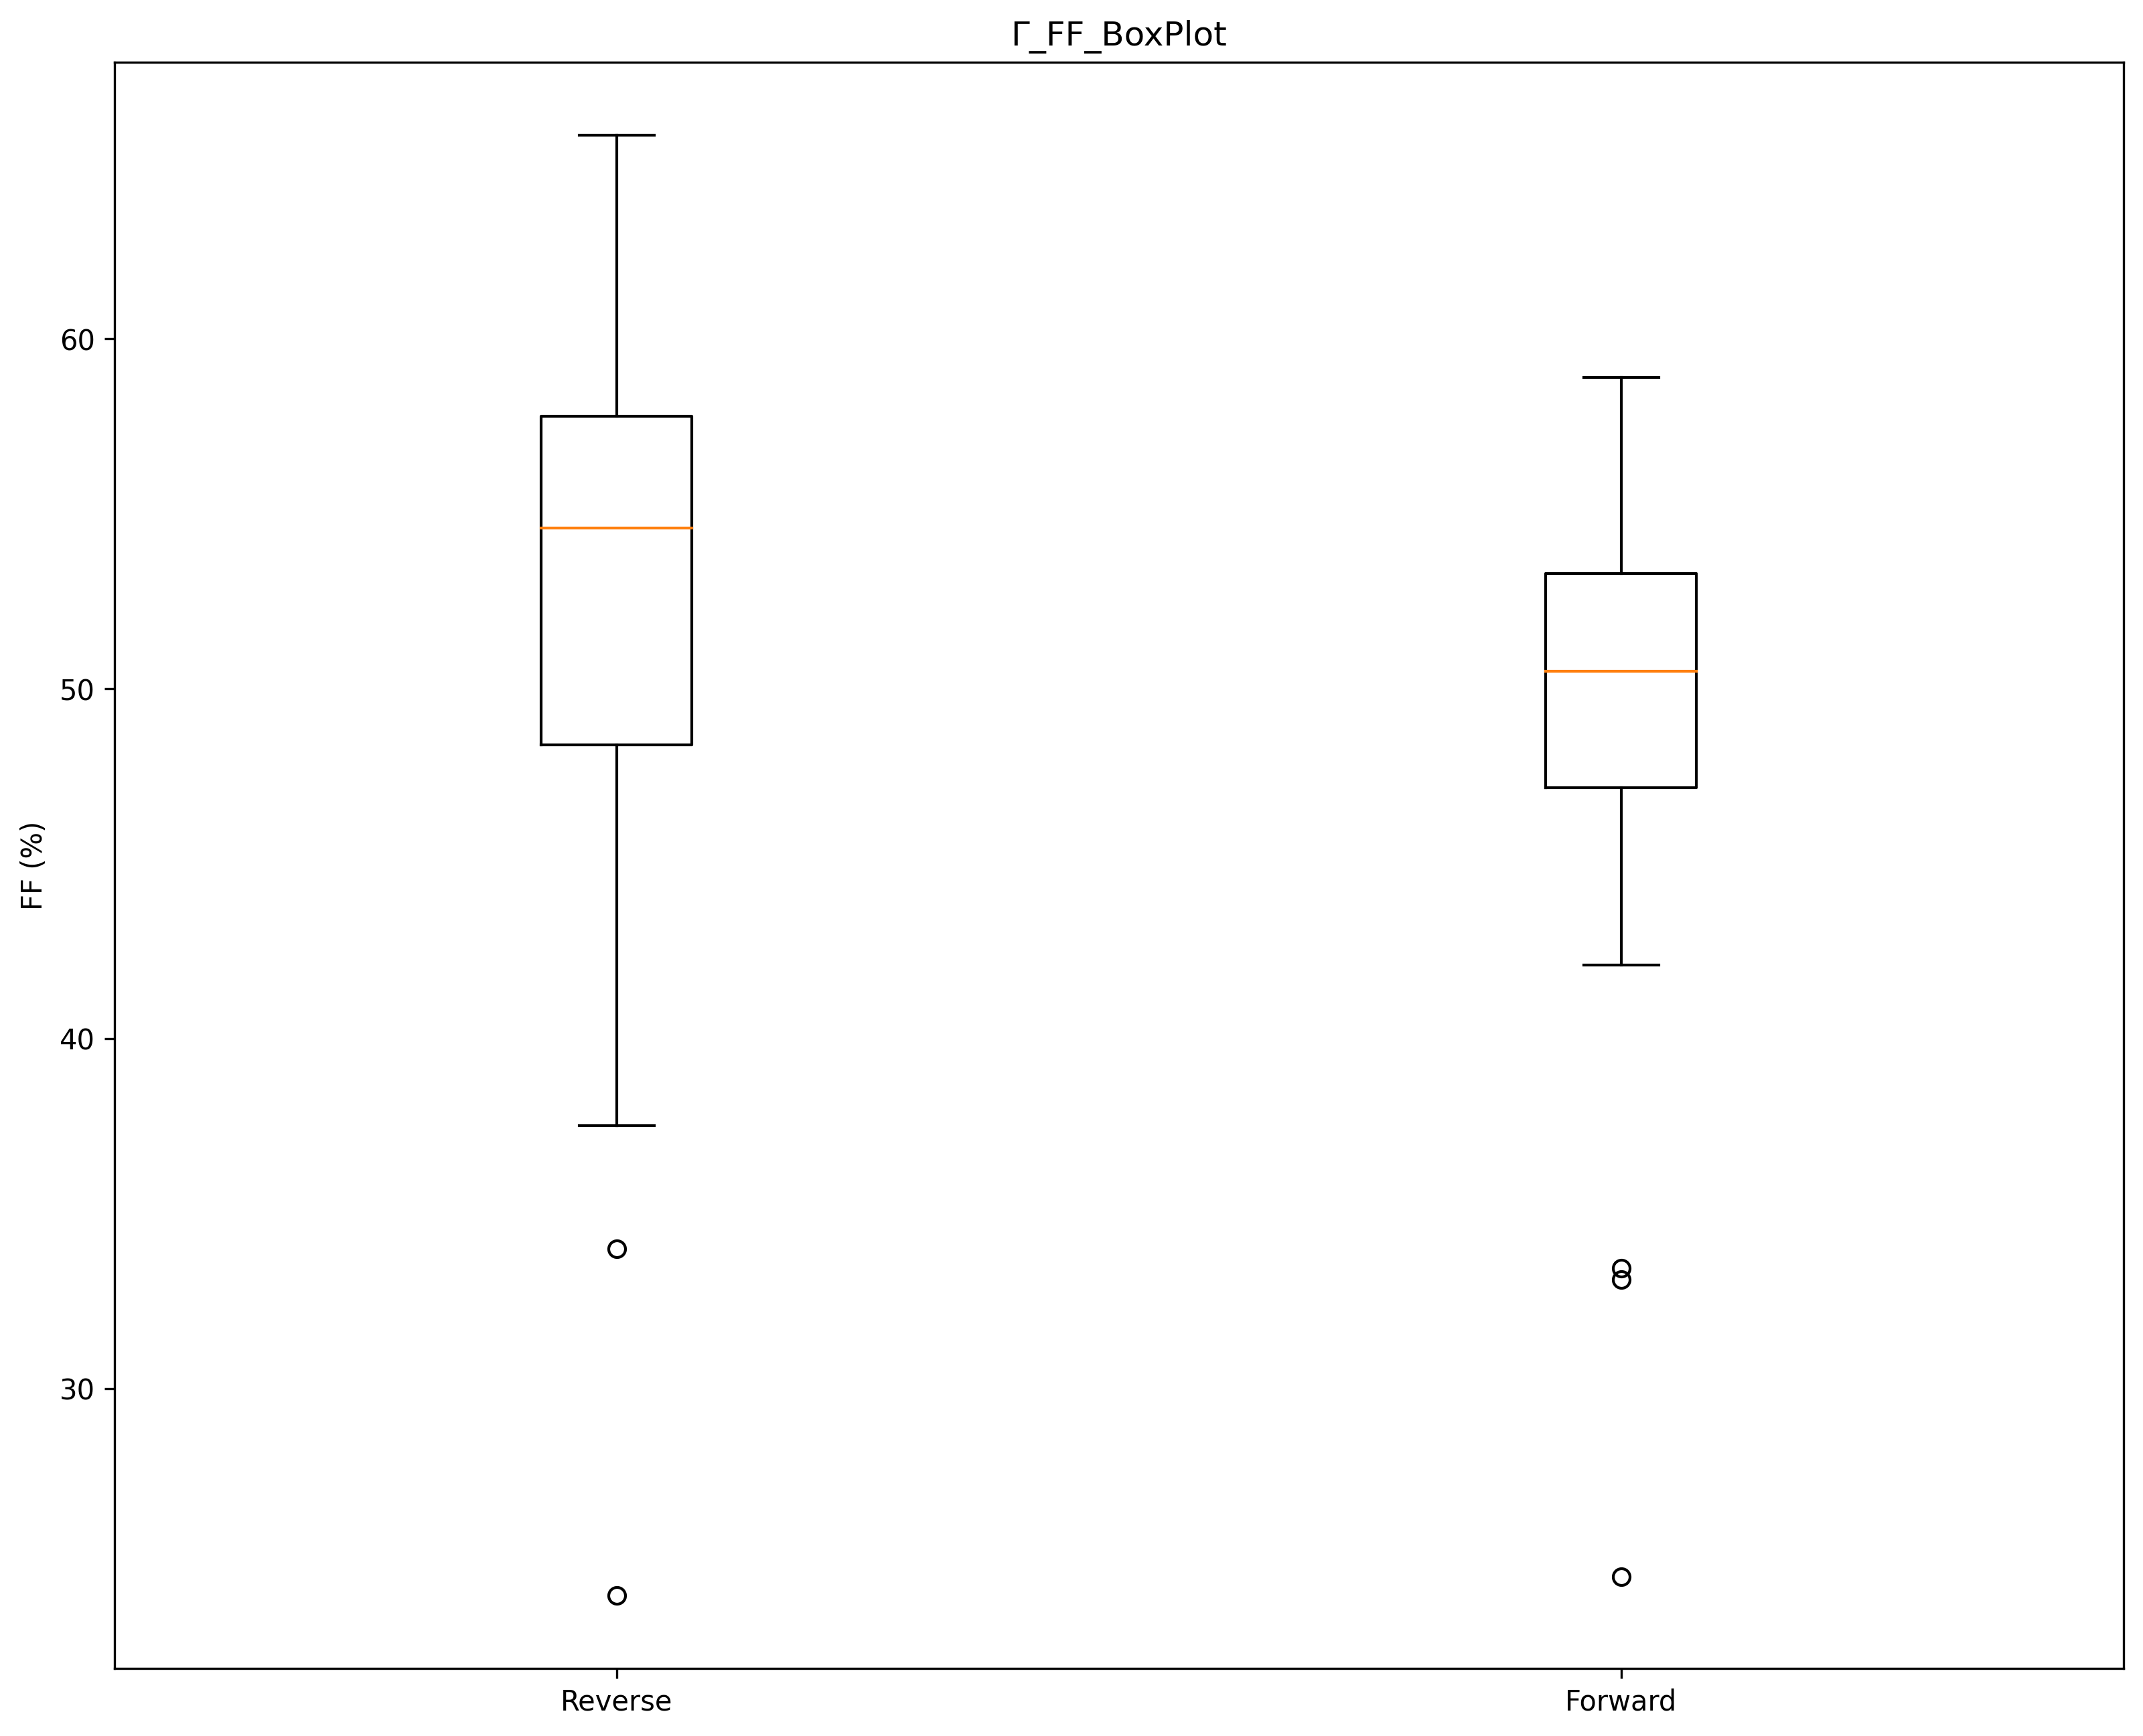
Fill factor
Litos Lite
My Setup
2.34% Difference on RV Scan

Slide 8
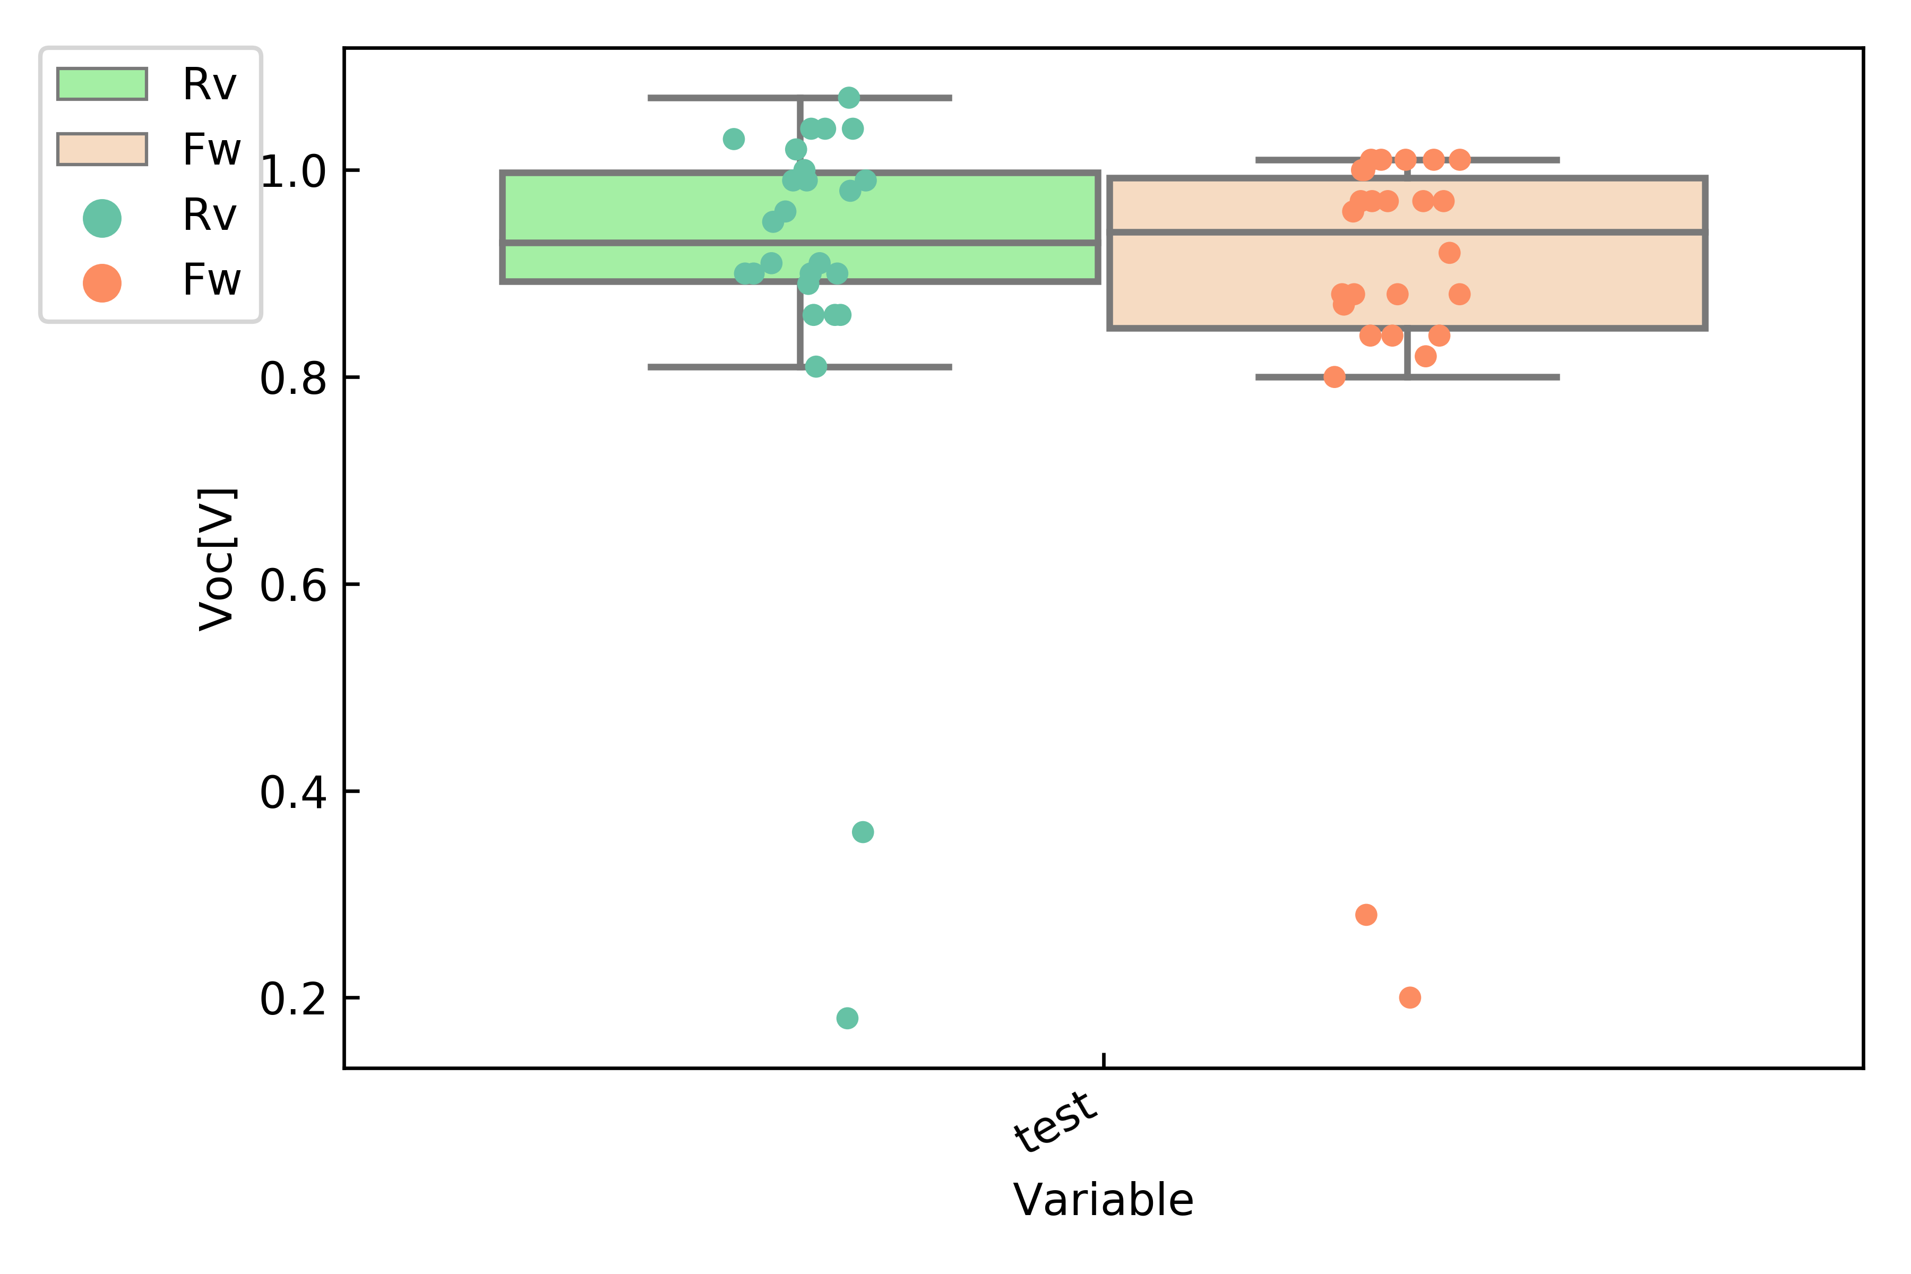
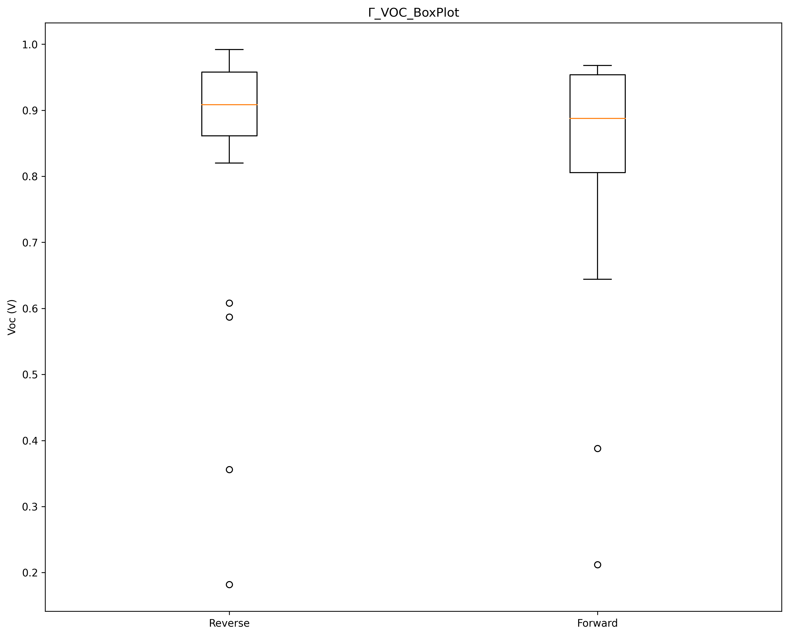
open circuit voltage
Litos Lite
My Setup
4.26% Difference on RV Scan

Slide 9
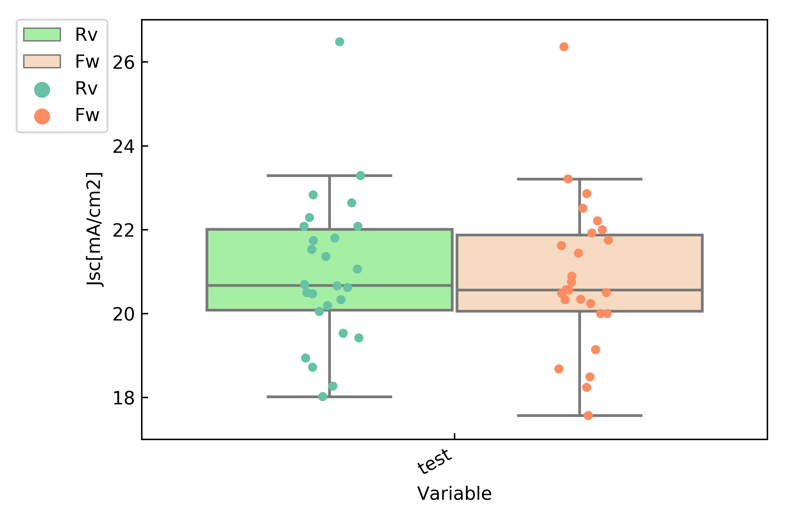
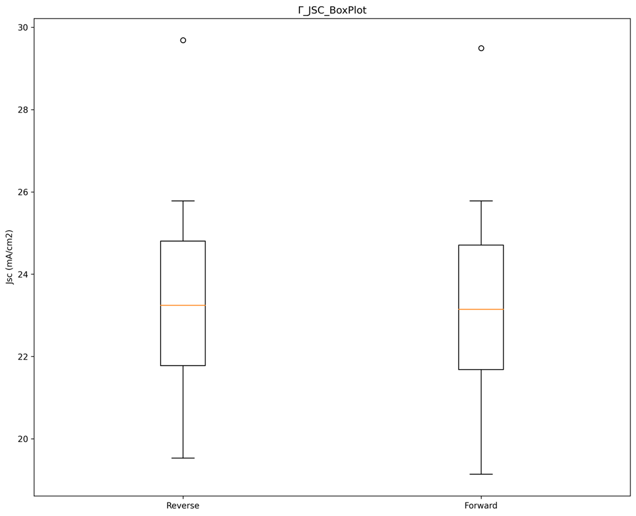
Short circuit current
Litos Lite
My Setup
13.02% Difference on RV Scan

Slide 10
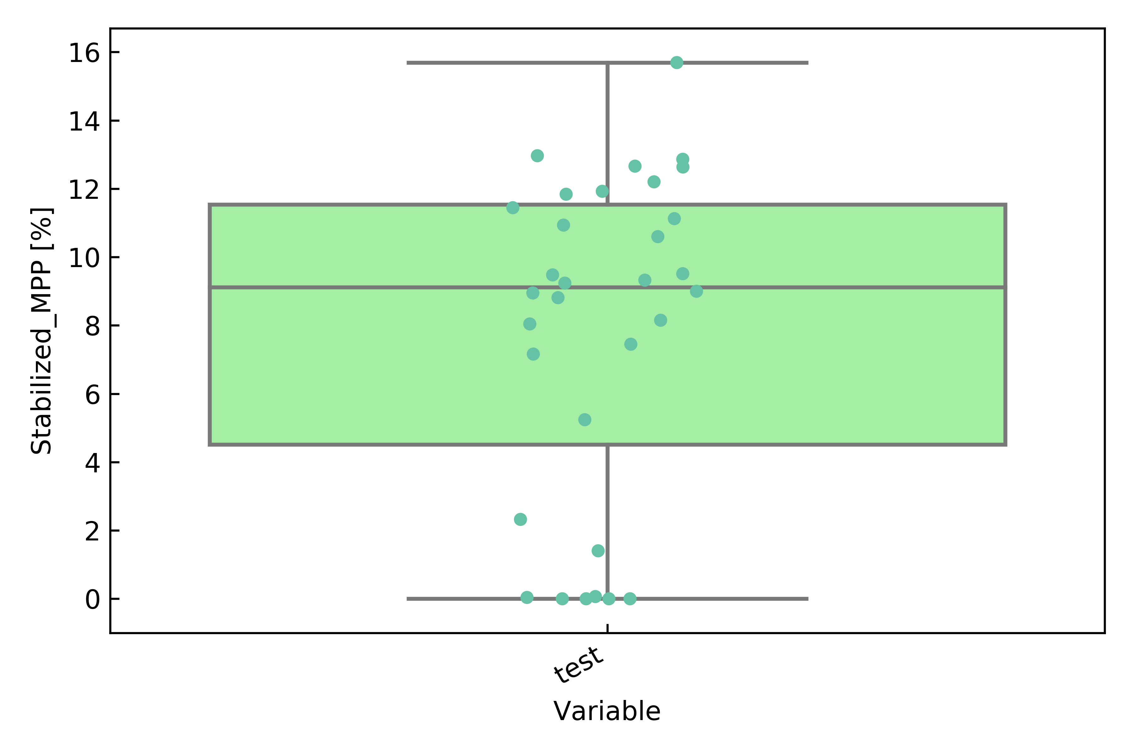
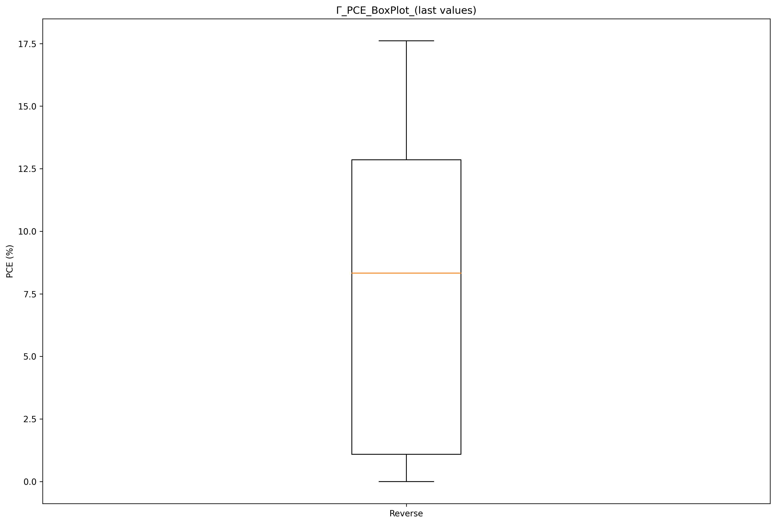
STABLIZED PCE (4 device setup: 4/25/2023)
Litos
My Setup

Slide 11
Next steps
Top Priority
Medium Priority
Low priority
Replicate performance of one device setup on 4 device parallel measurement.
Figure out bugs causing current measurement inaccuracies.
Develop solar simulator with low degradation at 1000 hrs of runtime
Develop sample holder to eliminate reliance on Litos Lite sample holder
Create Standard Operating Procedure manual
Improve user interface.
Improve usability of graph creation code.
Create detailed documentation for code

Slide 12
Thank you, Questions?
Andrew Chen
achen461@gatech.edu

